Slide 1
Pre-Project Presentation Development of AI Based Diet Consultant and exercise application Programme: B. Tech in CSE
Mentor : Dr. Rinki Sharma
Group No. : 31
Team Leader : Pasupuleti Rohithsaidatta
Department : Computer Science

Slide 2
Project Team
Sl no. | Registration no. | Students
1 | 19ETCS002083 | Pasupuleti Rohithsaidatta
2 | 19ETCS002152 | Rakesh kumar
3 | 19ETCS002098 | Rakshith
4 | 19ETCS002066 | Jayendra
5 | 19ETCS002081 | Nithin Krishna

Slide 3
Outline
Title and Aim
Objectives
Methods and Methodology ( or Block Diagram)
Results
Expected Outcomes
Cost Estimation
Gantt Chart
References

Slide 4
Title Development of AI Based Diet Consultant and exercise application To Create an application that efficiently help people to be healthy and delivering them with easier accessibility, to a new and innovative way towards the healthy lifestyle.
Aim

Slide 5
Introduction
Nowadays, people are suffering from many health issues due to lack of fitness and diet concerns. Therefore, we are developing this application to provide the AI dietician Consultant.
This AI based diet consultant and exercise application helps in providing customised daily diet and physical activities
The main advantage of using this AI basesd Diet Consultant application is it makes an efficient handy diet plan and physical challenges for every day to reach and maintain the fittest life of an individual cutting out the approach to real world dieticians in this busy day to day life

Slide 6
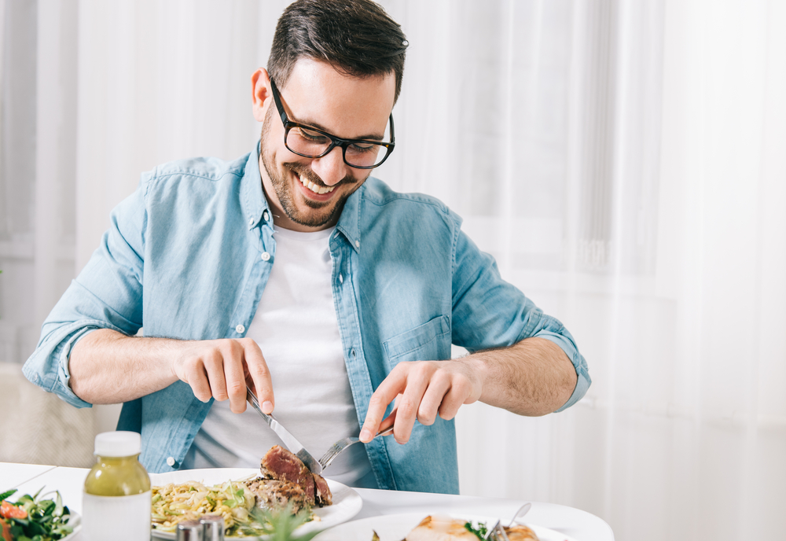
Motivation
Everyone today dreams of healthy life cycle.But In today’s busy life they are not able to fullfill due to unhealthy food and lack of proper physical workouts.
A balanced diet is necessary as your organs and tissues need proper nutrition to work effectively. Without good nutrition, your body is more prone to disease, infection, fatigue, and poor performance.

Slide 7
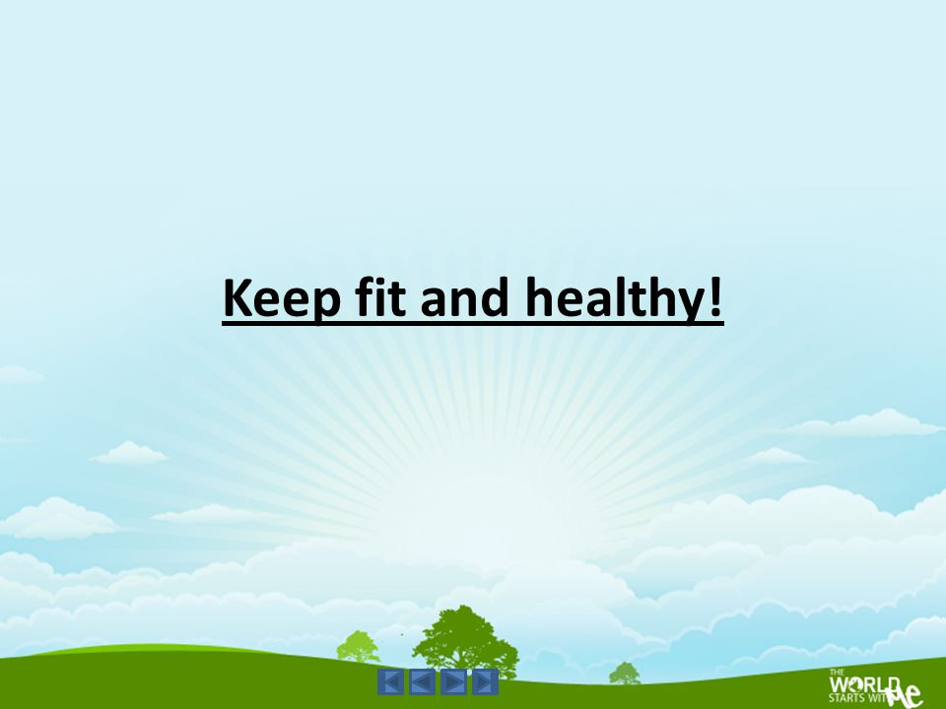
Motivation
People with a poor diet run the risk of growth and developmental problems and poor academic performance, and bad eating habits can persist for the rest of their lives.
Without good nutrition, your body is more prone to disease, infection, fatigue, and poor performance.
Balanced diet are foods that are low in unnecessary fats and sugars and high in vitamins, minerals, and other nutrients.
Calories play a vital role in our growth and energy.
A good diet can help you manipulate calorie intake based on your requirements.

Slide 8
Objectives
Gathering physical details such as medical histories, age, BMI, Weight and physiological parameters
Identify the most appropriate predefined trained dataset
Generate the diet plan accordingly to the customer preferences considering the allergies and over intake concerns of certain food items etc. based on the given medical history
Modify the diet plan based on the customer feedback to the shared diet plan
It must include the physical activities along with the diet plan undertaking the client current health

Slide 9
Methods and Methodology
Gathering physical details such as medical histories, age, BMI, Weight and physiological parameters
User having signed in or signed up to access the service Is supposed to enter the physical details such as weight, height, age , medical issues such as diabetics ,BP, asthma etc. and his physical activities
System asks the user the kind of concern he is seeking such as to lose, gain , maintain the weight or becoming fitter

Slide 10
Methods and Methodology
Identify the most appropriate predefined trained dataset
System matches the user entered data and the trained data set according to his mentioned concern and generates the plan
Generate the diet plan accordingly to the customer preferences considering the allergies and over intake concerns of certain food items etc. based on the given medical history
System edits the matched data set after looking up the above medical issues accordingly

Slide 11
Methods and Methodology
Modify the diet plan based on the customer feedback to the shared diet plan
Once system generates the dietplan it asks for customers feedback then alters the above diet plan agian according to the customer preferences
It must include the physical activities along with the diet plan undertaking the client current health
System also recommends the physical work outs for the efficiency to manage the calories from the trained dataset to the user

Slide 12
Block Diagram
AI DIET CONSULTANT
APPLICATION
User
Enter the physcical information along with current medical issues such as weight,age etc.
Based on the user information application generates the diet plan
Application lets the user to modify the current generated plan
Application also appends the physical activity
Signup/Login

Slide 13
Expected Outcomes
Successfully Development of Application.
Demonstration of working Model.

Slide 14
Cost Estimation
S.No. | Particulars/Components/Devices | Estimated Cost
1 | Laptop | 45,000
2
 | Total: | 45,000
Man hours:
Man hours per week (students): 18 *5 students = 90
Man hours per week (faculty): 3

Slide 15
Gantt Chart
Project Work (UG) 16 weeks
Week | 1 | 2 | 3 | 4 | 5 | 6 | 7 | 8 | 9 | 10 | 11 | 12 | 13 | 14 | 15 | 16
Major Activities
1.1
1.2
2.1
2.2
2.3
2.4
3.1
3.2
4.1
4.2
5.1
5.2
6.1
6.2

Slide 16
References
https://www.researchgate.net/publication/357352908_Artificial_Intelligence_Applications_in_Nutrition_and_Dietetics
https://www.nytimes.com/2022/03/14/well/eat/ai-diet-personalized.html
https://www.forbes.com/sites/ilkerkoksal/2020/03/07/how-ai-determines-the-diet-plans/?sh=7d29b7de3ed7

Slide 17
Thank You

